Slide 1
Evaluating DDIMs in New Domains
DDIMs vs WGANs
Cem Beyenal & Mason Menser

Slide 2
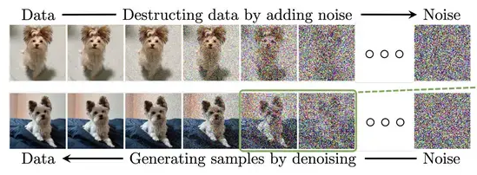
DDIMs
Denoising Diffusion Implicit Models
  An evolution from DDPMs within the class of Diffusion Models
  Steps
    Add noise to an image for T steps
    Reverse the forward process by predicting the added noise
  Training and inference times typically takes longer
  More reliable/quality image outputs
Notes:
DDIMs are a class of image
Steps:
First, you add Gaussian noise to a clean image for T steps. At the end of those steps, you essentially have just pure noise. This is called the forward pass. From there, we move to the Denoising process. This is where nueral networks come in, where the model learns to reverse the forward process. Essentially, at each step T, the model tries to predict the noise that was added. By predicting the noise, the model can create a slightly less noising image and eventually, after T steps, results in a clean image.

Slide 3
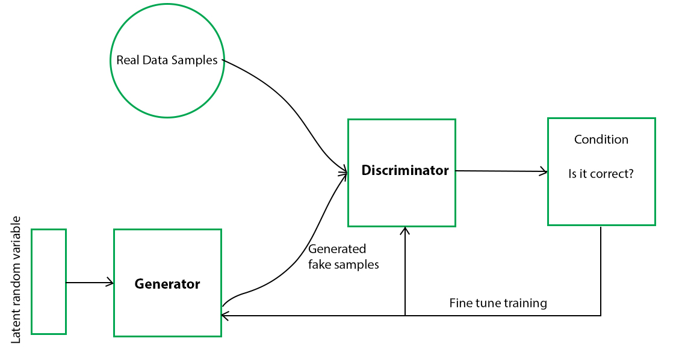
WGANs
Wasserstein Generative Adversarial Networks
An evolution from plain GANs, targeting mode collapse/training instability
Steps
  Critic: Grade images via WGAN loss function
  Generator: Create images that Critic rates highly
Discriminator is more useful in WGANs
Quicker training & inference times w/ quality images

Slide 4
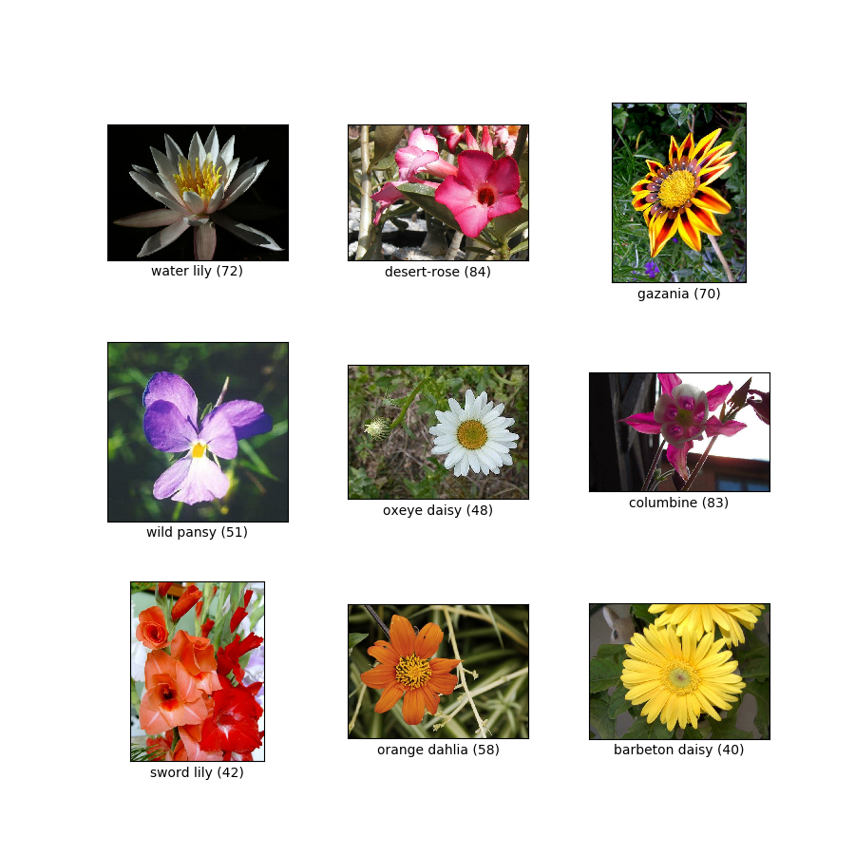
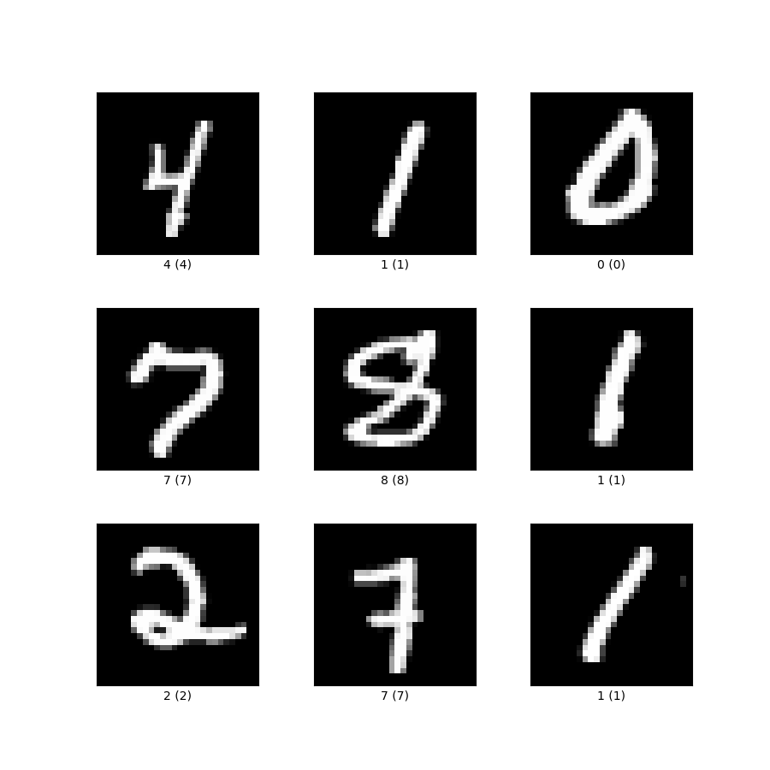
Approach
Compare model performance on two datasets
  Flowers102
  MNIST
Metrics
  Training time
  Inference time
  KID (Kernel Inception Distance)
    Pass real and generated images thru Inception-v3
    Captures high-level, relevant, semantic features of the images
Notes:
MNIST is simpler and has been used much more than Flowers102.

Slide 5
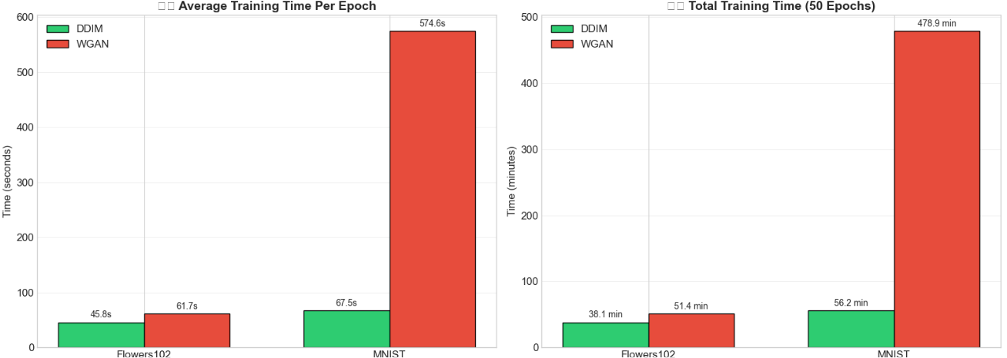
Findings – Training Time
Need to think about what were doing here

Slide 6
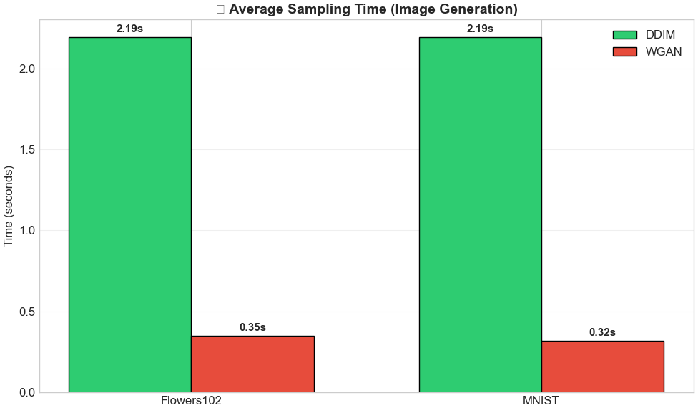
Finding – Inference Time
On average, DDIMs are 6.2x slower w/ inference
Expected given model architecture

Slide 7
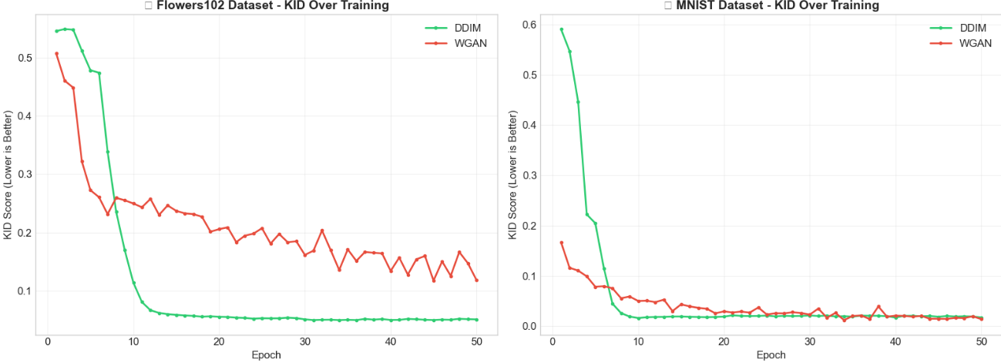
Finding – Image Quality using KID
Minimum KID
  DDIM: 0.0495
  WGAN: 0.1173
Minimum KID
  DDIM: 0.0162
  WGAN: 0.0121

Slide 8
Conclusions
DDIMs take longer and are more complex to implement
On more complex datasets, DDIMs are higher quality

